Slide 1
Data Mining & Business Intelligence
Module 3:Classification

Slide 2
Index -
Lecture 12 – Basic Concepts | 4
Lecture 13 –Decision Tree Induction | 12
Lecture 14 –Attributes Selection Measures and Pruning | 23
Lecture 15 - Measuring similarity and dissimilarity. | 35

Slide 3
Lectur12
Basic Concepts

Slide 4
Supervised vs. Unsupervised Learning
Supervised learning (classification)
  Supervision: The training data (observations, measurements, etc.) are accompanied by labels indicating the class of the observations
  New data is classified based on the training set
Unsupervised learning (clustering)
  The class labels of training data is unknown
  Given a set of measurements, observations, etc. with the aim of establishing the existence of classes or clusters in the data
  Training set is the one on which we train and fit our model basically to fit the parameters whereas test data is used only to assess the performance of model. Training data's output is available to model whereas testing data is the unseen data for which predictions have to be made.
Lecture 12 -Basic Concepts

Slide 5
Prediction Problems: Classification vs. Numeric Prediction
Classification
  predicts categorical class labels (discrete or nominal)
  classifies data (constructs a model) based on the training set and the values (class labels) in a classifying attribute and uses it in classifying new data
Numeric Prediction
  models continuous-valued functions, i.e., predicts unknown or missing values
Typical applications
  Credit/loan approval:
  Medical diagnosis: if a tumor is cancerous or benign
  Fraud detection: if a transaction is fraudulent
  Web page categorization: which category it is
Lecture 12 -Basic Concepts

Slide 6
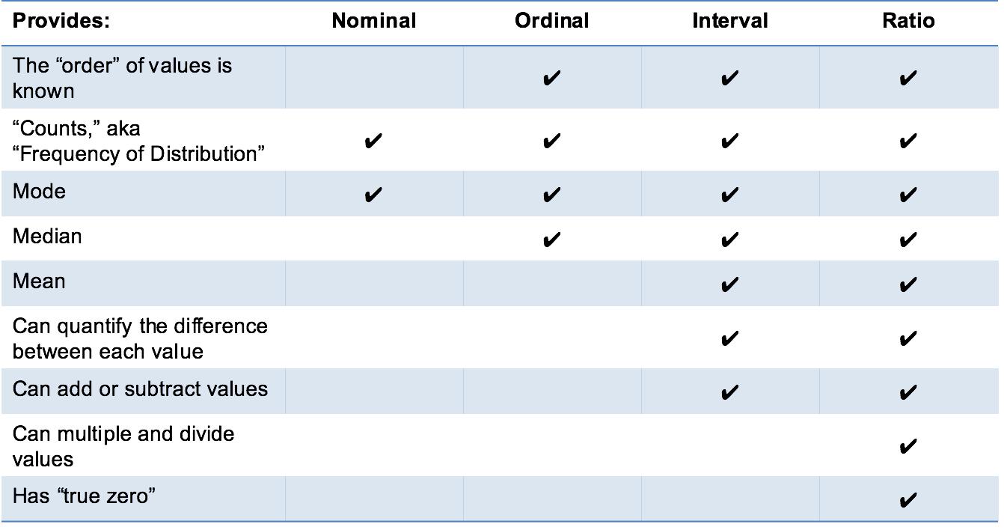
Attribute types
Lecture 12 -Basic Concepts

Slide 7
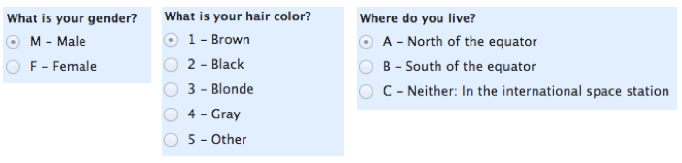
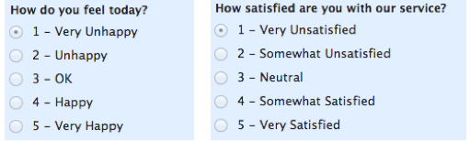
Nominal and ordinal
Nominal Data
Ordinal Data
Lecture 12 -Basic Concepts

Slide 8
Classification—A Two-Step Process
Model construction: describing a set of predetermined classes
  Each tuple/sample is assumed to belong to a predefined class, as determined by the class label attribute
  The set of tuples used for model construction is training set
  The model is represented as classification rules, decision trees, or mathematical formulae
Model usage: for classifying future or unknown objects
  Estimate accuracy of the model
    The known label of test sample is compared with the classified result from the model
    Accuracy rate is the percentage of test set samples that are correctly classified by the model
    Test set is independent of training set (otherwise overfitting)
  If the accuracy is acceptable, use the model to classify new data
Note: If the test set is used to select models, it is called validation (test) set
Lecture 12 -Basic Concepts

Slide 9



Process (1): Model Construction
Classification
Algorithms
Training
Data
Classifier
(Model)
IF rank = ‘professor’
OR years > 6
THEN tenured = ‘yes’
Lecture 12 -Basic Concepts

Slide 10




Process (2): Using the Model in Prediction
Classifier
Testing
Data
Unseen Data
(Jeff, Professor, 4)
Tenured?
Lecture 12 -Basic Concepts

Slide 11
Lectur13
Decision Tree Induction

Slide 12

Decision Tree Induction: An Example
Training data set: Buys_computer
The data set follows an example of Quinlan’s ID3 (Playing Tennis)
Resulting tree:
age?
<=30
overcast
>40
31..40
student?
yes
credit rating?
no
yes
excellent
fair
no
yes
no
yes

Slide 13
Algorithm for Decision Tree Induction
Basic algorithm (a greedy algorithm)
  Tree is constructed in a top-down recursive divide-and-conquer manner
  At start, all the training examples are at the root
  Attributes are categorical (if continuous-valued, they are discretized in advance)
  Examples are partitioned recursively based on selected attributes
  Test attributes are selected on the basis of a heuristic or statistical measure (e.g., information gain)
Conditions for stopping partitioning
  All samples for a given node belong to the same class
  There are no remaining attributes for further partitioning – majority voting is employed for classifying the leaf
  There are no samples left
Lecture 13 -Decision Tree Induction

Slide 14
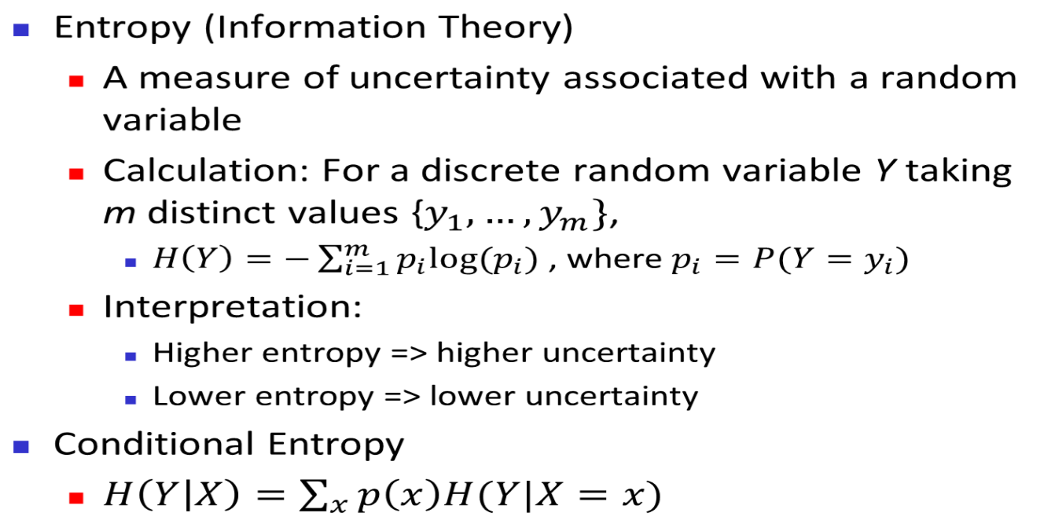

Brief Review of Entropy
m = 2
Lecture 13 -Decision Tree Induction

Slide 15



Attribute Selection Measure: Information Gain (ID3/C4.5)
Select the attribute with the highest information gain
Let p_{i} be the probability that an arbitrary tuple in D belongs to class C_{i}, estimated by |C_{i, D}|/|D|
Expected information (entropy) needed to classify a tuple in D:
Information needed (after using A to split D into v partitions) to classify D:
Information gained by branching on attribute A
Notes:
I : the expected information needed to classify a given sample
E (entropy) : expected information based on the partitioning into subsets by A

Slide 16






Attribute Selection: Information Gain
Class P: buys_computer = “yes”
Class N: buys_computer = “no”
means “age <=30” has 5 out of 14 samples, with 2 yes’es and 3 no’s. Hence
Similarly,
Lecture 13 -Decision Tree Induction

Slide 17
Computing Information-Gain for Continuous-Valued Attributes
Let attribute A be a continuous-valued attribute
Must determine the best split point for A
  Sort the value A in increasing order
  Typically, the midpoint between each pair of adjacent values is considered as a possible split point
    (a_{i}+a_{i+1})/2 is the midpoint between the values of a_{i} and a_{i+1}
  The point with the minimum expected information requirement for A is selected as the split-point for A
Split:
  D1 is the set of tuples in D satisfying A ≤ split-point, and D2 is the set of tuples in D satisfying A > split-point
Lecture 13 -Decision Tree Induction

Slide 18

Gain Ratio for Attribute Selection (C4.5)
Information gain measure is biased towards attributes with a large number of values
C4.5 (a successor of ID3) uses gain ratio to overcome the problem (normalization to information gain)
  GainRatio(A) = Gain(A)/SplitInfo(A)
Ex.
  gain_ratio(income) = 0.029/1.557 = 0.019
The attribute with the maximum gain ratio is selected as the splitting attribute

Slide 19



Gini Index (CART, IBM IntelligentMiner)
If a data set D contains examples from n classes, gini index, gini(D) is defined as
where p_{j} is the relative frequency of class j in D
If a data set D is split on A into two subsets D₁ and D₂, the gini index gini(D) is defined as
Reduction in Impurity:
The attribute provides the smallest gini_{split}(D) (or the largest reduction in impurity) is chosen to split the node (need to enumerate all the possible splitting points for each attribute)

Slide 20



Computation of Gini Index
Ex. D has 9 tuples in buys_computer = “yes” and 5 in “no”
Suppose the attribute income partitions D into 10 in D₁: {low, medium} and 4 in D₂
  Gini_{{low,high}} is 0.458; Gini_{{medium,high}} is 0.450. Thus, split on the {low,medium} (and {high}) since it has the lowest Gini index
All attributes are assumed continuous-valued
May need other tools, e.g., clustering, to get the possible split values
Can be modified for categorical attributes

Slide 21
Comparing Attribute Selection Measures
The three measures, in general, return good results but
  Information gain:
    biased towards multivalued attributes
  Gain ratio:
    tends to prefer unbalanced splits in which one partition is much smaller than the others
  Gini index:
    biased to multivalued attributes
    has difficulty when # of classes is large
    tends to favor tests that result in equal-sized partitions and purity in both partitions
Lecture 13 –Attribues Sélection Measures and Pruning

Slide 22
Lectur13
Attribute Selection Measures and Pruning

Slide 23
Other Attribute Selection Measures
CHAID: a popular decision tree algorithm, measure based on χ² test for independence
C-SEP: performs better than info. gain and gini index in certain cases
G-statistic: has a close approximation to χ² distribution
MDL (Minimal Description Length) principle (i.e., the simplest solution is preferred):
  The best tree as the one that requires the fewest # of bits to both (1) encode the tree, and (2) encode the exceptions to the tree
Multivariate splits (partition based on multiple variable combinations)
  CART: finds multivariate splits based on a linear comb. of attrs.
Which attribute selection measure is the best?
  Most give good results, none is significantly superior than others
Lecture 13 –Attribues Sélection Measures and Pruning

Slide 24
Pruning
Pruning is a technique in machine learning that reduces the size of decision trees by removing sections of the tree that provide little power to classify instances. Pruning reduces the complexity of the final classifier, and hence improves predictive accuracy by the reduction of Overfitting
Two approaches to avoid overfitting
  Prepruning: Halt tree construction early ̵ do not split a node if this would result in the goodness measure falling below a threshold
    Difficult to choose an appropriate threshold
  Postpruning: Remove branches from a “fully grown” tree—get a sequence of progressively pruned trees
    Use a set of data different from the training data to decide which is the “best pruned tree”
Lecture 13 –Attribues Sélection Measures and Pruning

Slide 25
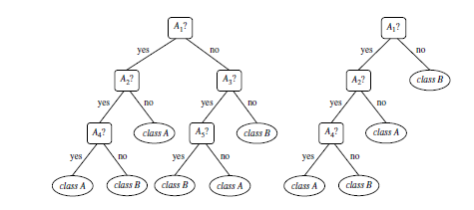
Pruning Example
Unpruned Tree Pruned Tree
Lecture 13 –Attribues Sélection Measures and Pruning

Slide 26
Enhancements to Basic Decision Tree Induction
Allow for continuous-valued attributes
  Dynamically define new discrete-valued attributes that partition the continuous attribute value into a discrete set of intervals
Handle missing attribute values
  Assign the most common value of the attribute
  Assign probability to each of the possible values
Attribute construction
  Create new attributes based on existing ones that are sparsely represented
  This reduces fragmentation, repetition, and replication
Lecture 13 –Attribues Sélection Measures and Pruning

Slide 27
Classification in Large Databases
Classification—a classical problem extensively studied by statisticians and machine learning researchers
Scalability: Classifying data sets with millions of examples and hundreds of attributes with reasonable speed
Why is decision tree induction popular?
  relatively faster learning speed (than other classification methods)
  convertible to simple and easy to understand classification rules
  can use SQL queries for accessing databases
  comparable classification accuracy with other methods
RainForest (VLDB’98 — Gehrke, Ramakrishnan & Ganti)
  Builds an AVC-list (attribute, value, class label)
Lecture 13 –Attribues Sélection Measures and Pruning

Slide 28
Scalability Framework for RainForest
Separates the scalability aspects from the criteria that determine the quality of the tree
Builds an AVC-list: AVC (Attribute, Value, Class_label)
AVC-set (of an attribute X )
  Projection of training dataset onto the attribute X and class label where counts of individual class label are aggregated
AVC-group (of a node n )
  Set of AVC-sets of all predictor attributes at the node n
Lecture 13 –Attribues Sélection Measures and Pruning

Slide 29

Rainforest: Training Set and Its AVC Sets
Training Examples
student | Buy_Computer
 | yes | no
yes | 6 | 1
no | 3 | 4
AVC-set on Age
AVC-set on income
income | Buy_Computer
 | yes | no
high | 2 | 2
medium | 4 | 2
low | 3 | 1
Age | Buy_Computer
 | yes | no
<=30 | 2 | 3
31..40 | 4 | 0
>40 | 3 | 2
AVC-set on
credit_rating
AVC-set on Student
Credit rating | Buy_Computer
 | yes | no
fair | 6 | 2
excellent | 3 | 3

Slide 30
BOAT (Bootstrapped Optimistic Algorithm for Tree Construction)
Use a statistical technique called bootstrapping to create several smaller samples (subsets), each fits in memory
Each subset is used to create a tree, resulting in several trees
These trees are examined and used to construct a new tree T’
  It turns out that T’ is very close to the tree that would be generated using the whole data set together
Adv: requires only two scans of DB, an incremental alg.
Lecture 13 –Attribues Sélection Measures and Pruning

Slide 31

Presentation of Classification Results
Lecture 13 –Attribues Sélection Measures and Pruning

Slide 32

Visualization of a Decision Tree in SGI/MineSet 3.0
Lecture 13 –Attribues Sélection Measures and Pruning

Slide 33

Interactive Visual Mining by Perception-Based Classification (PBC)
Lecture 13 –Attribues Sélection Measures and Pruning

Slide 34
Lectur15
Bayesian Classification

Slide 35
Bayesian Classification: Why?
A statistical classifier: performs probabilistic prediction, i.e., predicts class membership probabilities
Foundation: Based on Bayes’ Theorem.
Performance: A simple Bayesian classifier, naïve Bayesian classifier, has comparable performance with decision tree and selected neural network classifiers
Incremental: Each training example can incrementally increase/decrease the probability that a hypothesis is correct — prior knowledge can be combined with observed data
Standard: Even when Bayesian methods are computationally intractable, they can provide a standard of optimal decision making against which other methods can be measured
Lecture 15 –Bayesian Classification

Slide 36


Bayes’ Theorem: Basics
Total probability Theorem:
Bayes’ Theorem:
  Let X be a data sample (“evidence”): class label is unknown
  Let H be a hypothesis that X belongs to class C
  Classification is to determine P(H|X), (i.e., posteriori probability): the probability that the hypothesis holds given the observed data sample X
  P(H) (prior probability): the initial probability
    E.g., X will buy computer, regardless of age, income, …
  P(X): probability that sample data is observed
  P(X|H) (likelihood): the probability of observing the sample X, given that the hypothesis holds
    E.g., Given that X will buy computer, the prob. that X is 31..40, medium income
Lecture 15 –Bayesian Classification

Slide 37
Prediction Based on Bayes’ Theorem
Given training data X, posteriori probability of a hypothesis H, P(H|X), follows the Bayes’ theorem
Informally, this can be viewed as
  posteriori = likelihood x prior/evidence
Predicts X belongs to C_{i} iff the probability P(C_{i}|X) is the highest among all the P(C_{k}|X) for all the k classes
Practical difficulty: It requires initial knowledge of many probabilities, involving significant computational cost
Lecture 15 –Bayesian Classification

Slide 38
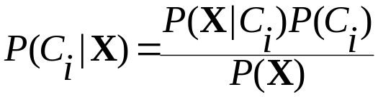

Classification Is to Derive the Maximum Posteriori
Let D be a training set of tuples and their associated class labels, and each tuple is represented by an n-D attribute vector X = (x₁, x₂, …, x_{n})
Suppose there are m classes C₁, C₂, …, C_{m}.
Classification is to derive the maximum posteriori, i.e., the maximal P(C_{i}|X)
This can be derived from Bayes’ theorem
Since P(X) is constant for all classes, only
  needs to be maximized

Slide 39
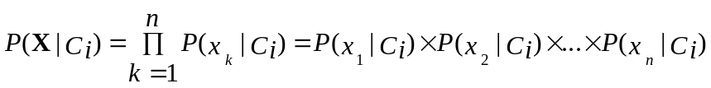


Naïve Bayes Classifier
A simplified assumption: attributes are conditionally independent (i.e., no dependence relation between attributes):
This greatly reduces the computation cost: Only counts the class distribution
If A_{k} is categorical, P(x_{k}|C_{i}) is the # of tuples in C_{i} having value x_{k} for A_{k} divided by |C_{i, D}| (# of tuples of C_{i} in D)
If A_{k} is continous-valued, P(x_{k}|C_{i}) is usually computed based on Gaussian distribution with a mean μ and standard deviation σ
  and P(x_{k}|C_{i}) is

Slide 40

Naïve Bayes Classifier: Training Dataset
Class:
C1:buys_computer = ‘yes’
C2:buys_computer = ‘no’
Data to be classified:
X = (age <=30,
Income = medium,
Student = yes
Credit_rating = Fair)
Lecture 15 –Bayesian Classification

Slide 41
Naïve Bayes Classifier: An Example
P(C_{i}): P(buys_computer = “yes”) = 9/14 = 0.643
P(buys_computer = “no”) = 5/14= 0.357
Compute P(X|C_{i}) for each class
  P(age = “<=30” | buys_computer = “yes”) = 2/9 = 0.222
  P(age = “<= 30” | buys_computer = “no”) = 3/5 = 0.6
  P(income = “medium” | buys_computer = “yes”) = 4/9 = 0.444
  P(income = “medium” | buys_computer = “no”) = 2/5 = 0.4
  P(student = “yes” | buys_computer = “yes) = 6/9 = 0.667
  P(student = “yes” | buys_computer = “no”) = 1/5 = 0.2
  P(credit_rating = “fair” | buys_computer = “yes”) = 6/9 = 0.667
  P(credit_rating = “fair” | buys_computer = “no”) = 2/5 = 0.4
X = (age <= 30 , income = medium, student = yes, credit_rating = fair)
P(X|C_{i}) : P(X|buys_computer = “yes”) = 0.222 x 0.444 x 0.667 x 0.667 = 0.044
P(X|buys_computer = “no”) = 0.6 x 0.4 x 0.2 x 0.4 = 0.019
P(X|C_{i})*P(C_{i}) : P(X|buys_computer = “yes”) * P(buys_computer = “yes”) = 0.028
P(X|buys_computer = “no”) * P(buys_computer = “no”) = 0.007
Therefore, X belongs to class (“buys_computer = yes”)
Lecture 15 –Bayesian Classification

Slide 42
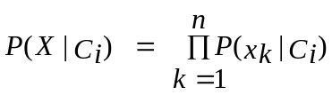
Avoiding the Zero-Probability Problem
Naïve Bayesian prediction requires each conditional prob. be non-zero. Otherwise, the predicted prob. will be zero
Ex. Suppose a dataset with 1000 tuples, income=low (0), income= medium (990), and income = high (10)
Use Laplacian correction (or Laplacian estimator)
  Adding 1 to each case
    Prob(income = low) = 1/1003
    Prob(income = medium) = 991/1003
    Prob(income = high) = 11/1003
  The “corrected” prob. estimates are close to their “uncorrected” counterparts

Slide 43
Naïve Bayes Classifier: Comments
Advantages
  Easy to implement
  Good results obtained in most of the cases
Disadvantages
  Assumption: class conditional independence, therefore loss of accuracy
  Practically, dependencies exist among variables
    E.g., hospitals: patients: Profile: age, family history, etc.
      Symptoms: fever, cough etc., Disease: lung cancer, diabetes, etc.
    Dependencies among these cannot be modeled by Naïve Bayes Classifier
How to deal with these dependencies? Bayesian Belief Networks (Chapter 9)
Lecture 15 –Bayesian Classification

Slide 44
Thank You

